Slide 1
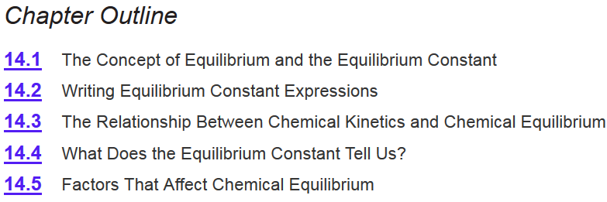
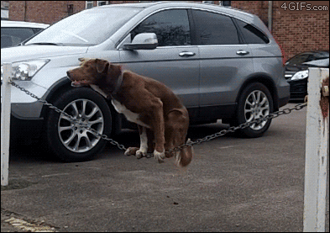

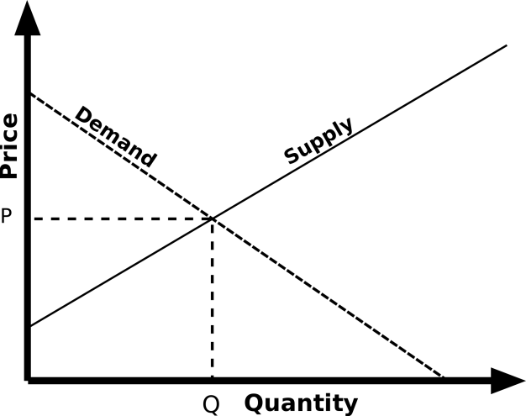
Chapter 14
Ch 14
Page 623

Slide 2
Equilibrium Constant
For a general reversible reaction such as:
aA + bB cC + dD
Equilibrium constants can be expressed using K_{c} or K_{p}.
K_{c} uses the concentration of reactants and products.
K_{p} uses the pressure of the gaseous reactants and products.
[C]^{c}
[D]^{d}
K_{c} =
[A]ª
[B]^{b}
P_{C}^{c}
P_{D}^{d}
K_{p} =
P_{A}ª
P_{B}^{b}
I have K, now what?

Slide 3
I have K, now what?
We can:
Predict the direction in which a reaction mixture will proceed to reach equilibrium.
Calculate the concentration of reactants and products once equilibrium has been reached.
Predict if and which direction the equilibrium will shift upon perturbation.
Notes:
Only true for point of equilibrium.

Slide 4
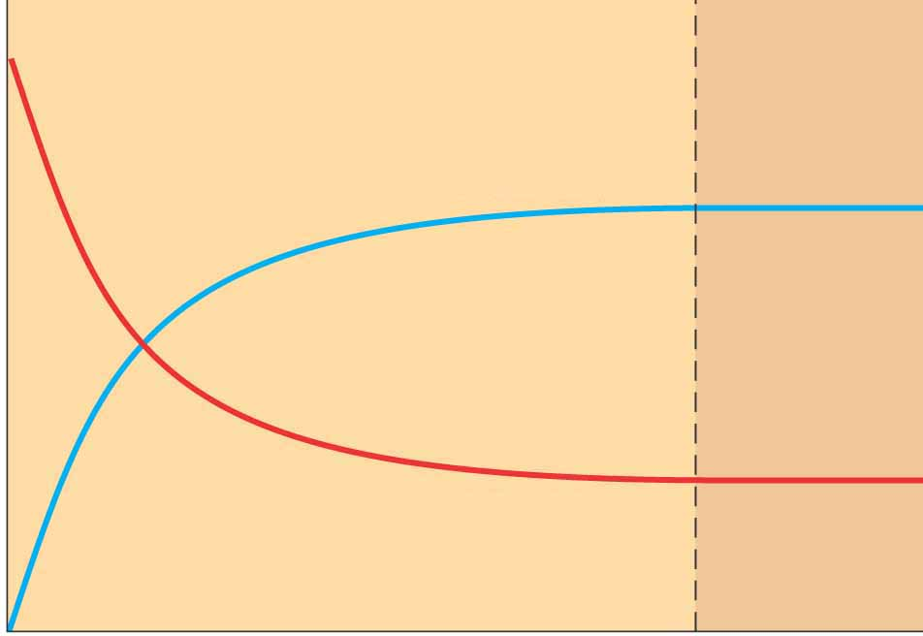
Reaction Quotient
Reaction Quotient- is a function of the concentrations or pressures of the chemical species involved in a chemical reaction.
aA bB
B
Number
A
At any time
time
At equilibrium
[B]
[B]
Q
=
K
=
[A]
[A]

Slide 5
Reaction Quotient
The reaction quotient Q has the same form as the equilibrium constant K
The major difference between Q and K is that the concentrations used in Q are not necessarily equilibrium values.
aA + bB cC + dD

Slide 6
Reaction Quotient
Why do we need Q if it does not use equilibrium concentrations?
The reaction quotient will help us predict how the equilibrium will respond to an applied stress:
aA + bB cC + dD
Q = K_{c}: the system is at equilibrium
Q < K_{c}: the reaction proceeds to the right
Q > K_{c}: the reaction proceeds to the left

Slide 7
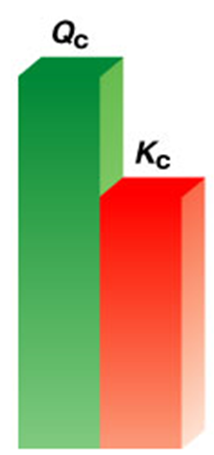
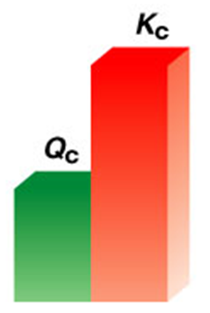

Reaction Quotient
[C]^{c}
[D]^{d}
[C]^{c}
[D]^{d}
K =
Q =
[A]ª
[B]^{b}
[A]ª
[B]^{b}
Q = K : the system is at equilibrium
Q < K : the reaction proceeds to the right
Q > K : the reaction proceeds to the left
Reaction will proceed until it reaches equilibrium.
Q < K
Q = K
Q > K
Not at equilibrium.
Not at equilibrium.

Slide 8

Not at equilibrium.
At equilibrium.
[C]^{c}
[D]^{d}
[C]^{c}
[D]^{d}
Q =
K =
[A]ª
[B]^{b}
[A]ª
[B]^{b}
Q < K
[C]^{c}
[D]^{d}
<
[C]^{c}
[D]^{d}
and/or
[A]ª
[B]^{b}
>
[A]ª
[B]^{b}
To reach equilibrium the reaction will:
shift to the right
generate more products
consume more reactants
aA + bB cC + dD

Slide 9
Reaction Quotient
aA + bB cC + dD
[C]^{c}
[D]^{d}
[C]^{c}
[D]^{d}
Q =
K =
[A]ª
[B]^{b}
[A]ª
[B]^{b}
Q = K_{c}: the system is at equilibrium
concentration of reactants and products stays the same
Q < K_{c}: the reaction proceeds to the right
generate more products, consume more reactant
Q > K_{c}: the reaction proceeds to the left
consume more products, generate more reactant
Can predict, if a reaction is not at equilibrium, which way will it shift?

Slide 10
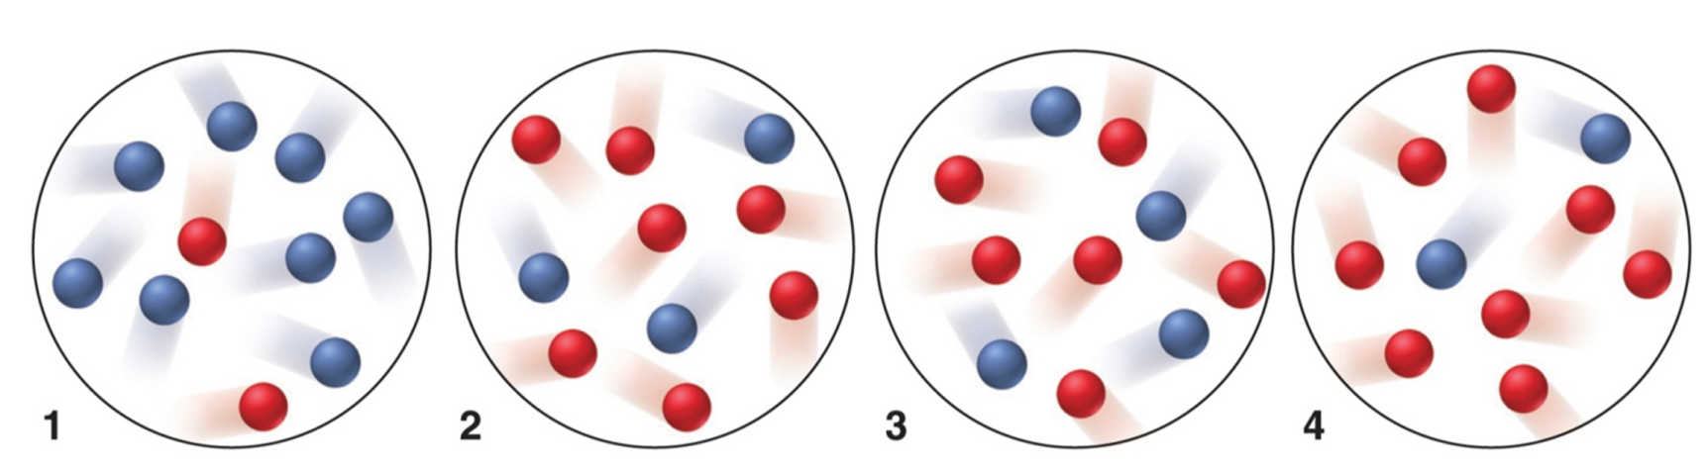
Example problem
A_{(g)} B_{(g)}
The equilibrium mixture at 175°C is [A] = 2.8x10⁻⁴ M and [B] = 1.2x10⁻⁴ M. The molecular scenes below represent mixtures at various times during runs 1-4 of this reaction. Do the reactions progress to the right or left or not at all for each mixture to reach equilibrium?

Slide 11
Solution
[B]
1.2x10⁻⁴
K_{c} =
=
= 0.43
[A]
2.8x10⁻⁴
Counting the red and blue spheres to calculate Q_{c} for each mixture:
1. Q_{c} = 8/2 = 4.0 2. Q_{c} = 3/7 = 0.43
3. Q_{c} = 4.6 = 0.67 4. Q_{c} = 2/8 = 0.25
Comparing Q_{c} with K_{c} to determine reaction direction:
1. Q_{c} > K_{c}; reaction proceeds to the left.
2. Q_{c} = K_{c}; no net change.
3. Q_{c} > K_{c}; reaction proceeds to the left.
4. Q_{c} < K_{c}; reaction proceeds to the right.

Slide 12
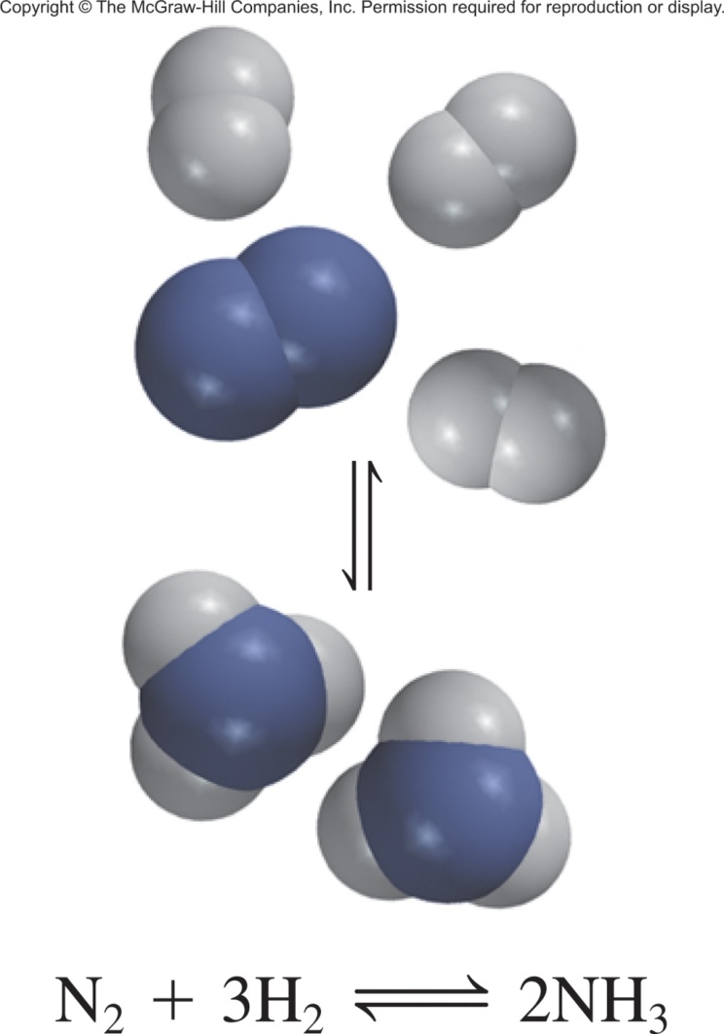
14.8
At the start of a reaction, there are 0.249 mol N₂, 3.21 x 10⁻² mol H₂, and 6.42 x 10⁻⁴ mol NH₃ in a 3.50-L reaction vessel at 375°C. If the equilibrium constant (K_{c}) for the reaction
N_{2(g)} + 3H_{2(g)} 2NH_{3(g)}
is 1.2 at this temperature, decide whether
the system is at equilibrium. If it is not,
predict which way the net reaction will
proceed.

Slide 13
14.8
The initial concentrations of the reacting species are
Now find Q:
K_{c} = 1.2
Q < K
N_{2(g)} + 3H_{2(g)} 2NH_{3(g)}

Slide 14

Going one step further
If we are given the concentrations in a reaction mixture and K_{c} we can predict which direction the reaction will proceed.
Q = K : the system is at equilibrium
Q < K : the reaction proceeds to the right
Q > K : the reaction proceeds to the left
We can also calculate the concentrations of each species when it reaches equilibrium.
Reaction Table
ICE Table/Method

Slide 15
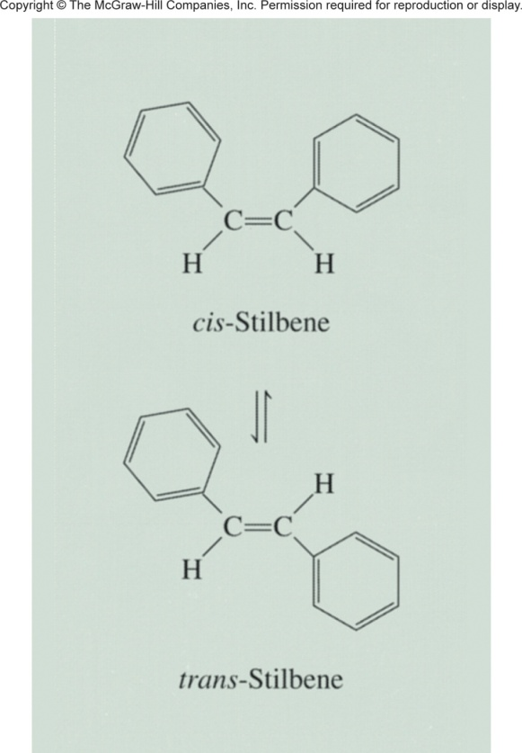
ICE Method
cis-Stilbene trans-Stilbene
The equilibrium constant (K_{c}) for this system is 24.0 at 200°C. Suppose that initially only cis-stilbene is present at a concentration of 0.850 mol/L. How do we calculate the concentrations of cis- and trans-stilbene at equilibrium?
Step 1: Construct an ICE Table.
Step 2: Insert known information into ICE Table (in M or pressure).
Step 3: Determine the change in conc (x) that will occur as the reaction progresses.
Step 4: Complete the table.
Step 5: Set up K equation, calculate x.
Step 6: Calculate equilibrium concs.

Slide 16
ICE Method
cis-stilbene trans-stilbene
The equilibrium constant (K_{c}) for this system is 24.0 at 200°C. Suppose that initially only cis-stilbene is present at a concentration of 0.850 mol/L. How do we calculate the concentrations of cis- and trans-stilbene at equilibrium?
Step 1: Construct an ICE Table.
Reactants Products
Initial (M):
Change (M):
Equilibrium (M):
cis-stilbene trans-stilbene

Slide 17
ICE Method
cis-stilbene trans-stilbene
The equilibrium constant (K_{c}) for this system is 24.0 at 200°C. Suppose that initially only cis-stilbene is present at a concentration of 0.850 mol/L. How do we calculate the concentrations of cis- and trans-stilbene at equilibrium?
Step 2: Insert known information into ICE Table (in M or pressure).
Reactants Products
Initial (M):
Change (M):
Equilibrium (M):
cis-stilbene trans-stilbene
0.850
0

Slide 18
ICE Method
cis-stilbene trans-stilbene
The equilibrium constant (K_{c}) for this system is 24.0 at 200°C. Suppose that initially only cis-stilbene is present at a concentration of 0.850 mol/L. How do we calculate the concentrations of cis- and trans-stilbene at equilibrium?
Step 3: Determine the change in conc (x) that will occur.
Reactants Products
Initial (M):
Change (M):
Equilibrium (M):
cis-stilbene trans-stilbene
0.850
0
-x
+x
[trans]
Q
=
= 0
[cis]

Slide 19
ICE Method
cis-stilbene trans-stilbene
The equilibrium constant (K_{c}) for this system is 24.0 at 200°C. Suppose that initially only cis-stilbene is present at a concentration of 0.850 mol/L. How do we calculate the concentrations of cis- and trans-stilbene at equilibrium?
Step 4: Complete the table.
Reactants Products
Initial (M):
Change (M):
Equilibrium (M):
cis-stilbene trans-stilbene
0.850
0
-x
+x
(0.850 - x)
x

Slide 20
ICE Method
cis-stilbene trans-stilbene
The equilibrium constant (K_{c}) for this system is 24.0 at 200°C. Suppose that initially only cis-stilbene is present at a concentration of 0.850 mol/L. How do we calculate the concentrations of cis- and trans-stilbene at equilibrium?
Step 5: Set up K equation, calculate x.
Reactants Products
Initial (M):
Change (M):
Equilibrium (M):
cis-stilbene trans-stilbene
0.850
0
-x
+x
(0.850 - x)
x
[trans]
x
K
=
= 24
=
x = 0.816 M
[cis]
0.850 - x

Slide 21
ICE Method
cis-stilbene trans-stilbene
The equilibrium constant (K_{c}) for this system is 24.0 at 200°C. Suppose that initially only cis-stilbene is present at a concentration of 0.850 mol/L. How do we calculate the concentrations of cis- and trans-stilbene at equilibrium?
Step 5: Set up K equation, calculate x.
Reactants Products
Initial (M):
Change (M):
Equilibrium (M):
cis-stilbene trans-stilbene
0.850
0
-x
+x
x = 0.816 M
(0.850 - x)
x
Equilibrium:
0.034 M
0.816 M

Slide 22
14.9
A mixture of 0.500 mol H₂ and 0.500 mol I₂ was placed in a 1.00-L stainless-steel flask at 430°C. The equilibrium constant K_{c} for the reaction H_{2(g)} + I_{2(g)} 2HI_{(g)} is 54.3 at this temperature. Calculate the concentrations of H₂, I₂, and HI at equilibrium.
Step 1: Construct an ICE Table.
Step 2: Insert known information into ICE Table (in M or pressure).
Step 3: Determine the change in conc (x) that will occur as the reaction progresses.
Step 4: Complete the table.
Step 5: Set up K equation, calculate x.
Step 6: Calculate equilibrium concs.

Slide 23
14.9
A mixture of 0.500 mol H₂ and 0.500 mol I₂ was placed in a 1.00-L stainless-steel flask at 430°C. The equilibrium constant K_{c} for the reaction H_{2(g)} + I_{2(g)} 2HI_{(g)} is 54.3 at this temperature. Calculate the concentrations of H₂, I₂, and HI at equilibrium.
Reactants Products
Initial (M):
Change (M):
Equilibrium (M):
H_{2(g)} + I_{2(g)} 2HI_{(g)}
0.5
0.5
0
- x
- x
2x
0.5 - x
0.5 - x
2x
[HI]²
(2x)²
(2x)²
K
=
= 54.3
=
=
[H₂]
[I₂]
(0.5-x)
(0.5-x)
(0.5-x)²

Slide 24
14.9
A mixture of 0.500 mol H₂ and 0.500 mol I₂ was placed in a 1.00-L stainless-steel flask at 430°C. The equilibrium constant K_{c} for the reaction H_{2(g)} + I_{2(g)} 2HI_{(g)} is 54.3 at this temperature. Calculate the concentrations of H₂, I₂, and HI at equilibrium.
Reactants Products
Initial (M):
Change (M):
Equilibrium (M):
H_{2(g)} + I_{2(g)} 2HI_{(g)}
0.5
0.5
0
- x
- x
2x
0.5 - x
0.5 - x
2x
(2x)²
54.3
=
(0.5-x)²

Slide 25
14.9
A mixture of 0.500 mol H₂ and 0.500 mol I₂ was placed in a 1.00-L stainless-steel flask at 430°C. The equilibrium constant K_{c} for the reaction H_{2(g)} + I_{2(g)} 2HI_{(g)} is 54.3 at this temperature. Calculate the concentrations of H₂, I₂, and HI at equilibrium.
Reactants Products
Initial (M):
Change (M):
Equilibrium (M):
H_{2(g)} + I_{2(g)} 2HI_{(g)}
0.5
0.5
0
- x
- x
2x
0.5 - x
0.5 - x
2x
Equilibrium:
0.107 M
0.107 M
0.786 M
x = 0.393 M

Slide 26
Chapter 14
Ch 14
Page 623

Slide 27
Equilibrium Constant
For a general reversible reaction such as:
aA + bB cC + dD
Equilibrium constants can be expressed using K_{c} or K_{p}.
K_{c} uses the concentration of reactants and products.
K_{p} uses the pressure of the gaseous reactants and products.
[C]^{c}
[D]^{d}
K_{c} =
[A]ª
[B]^{b}
P_{C}^{c}
P_{D}^{d}
K_{p} =
P_{A}ª
P_{B}^{b}
I have K, now what?

Slide 28
Reaction Quotient
Reaction Quotient- is a function of the concentrations or pressures of the chemical species involved in a chemical reaction.
aA bB
B
Number
A
At any time
time
At equilibrium
[B]
[B]
Q
=
K
=
[A]
[A]

Slide 29
Reaction Quotient
aA + bB cC + dD
[C]^{c}
[D]^{d}
[C]^{c}
[D]^{d}
Q =
K =
[A]ª
[B]^{b}
[A]ª
[B]^{b}
Q = K_{c}: the system is at equilibrium
concentration of reactants and products stays the same
Q < K_{c}: the reaction proceeds to the right
generate more products, consume more reactant
Q > K_{c}: the reaction proceeds to the left
consume more products, generate more reactant
Can predict, if a reaction is not at equilibrium, which way will it shift?

Slide 30
ICE Method
cis-Stilbene trans-Stilbene
The equilibrium constant (K_{c}) for this system is 24.0 at 200°C. Suppose that initially only cis-stilbene is present at a concentration of 0.850 mol/L. How do we calculate the concentrations of cis- and trans-stilbene at equilibrium?
Step 1: Construct an ICE Table.
Step 2: Insert known information into ICE Table (in M or pressure).
Step 3: Determine the change in conc (x) that will occur as the reaction progresses.
Step 4: Complete the table.
Step 5: Set up K equation, calculate x.
Step 6: Calculate equilibrium concs.

Slide 31
ICE Method
cis-stilbene trans-stilbene
The equilibrium constant (K_{c}) for this system is 24.0 at 200°C. Suppose that initially only cis-stilbene is present at a concentration of 0.850 mol/L. How do we calculate the concentrations of cis- and trans-stilbene at equilibrium?
Step 1: Construct an ICE Table.
Reactants Products
Initial (M):
Change (M):
Equilibrium (M):
cis-stilbene trans-stilbene

Slide 32
ICE Method
cis-stilbene trans-stilbene
The equilibrium constant (K_{c}) for this system is 24.0 at 200°C. Suppose that initially only cis-stilbene is present at a concentration of 0.850 mol/L. How do we calculate the concentrations of cis- and trans-stilbene at equilibrium?
Step 2: Insert known information into ICE Table (in M or pressure).
Reactants Products
Initial (M):
Change (M):
Equilibrium (M):
cis-stilbene trans-stilbene
0.850
0

Slide 33
ICE Method
cis-stilbene trans-stilbene
The equilibrium constant (K_{c}) for this system is 24.0 at 200°C. Suppose that initially only cis-stilbene is present at a concentration of 0.850 mol/L. How do we calculate the concentrations of cis- and trans-stilbene at equilibrium?
Step 3: Determine the change in conc (x) that will occur.
Reactants Products
Initial (M):
Change (M):
Equilibrium (M):
cis-stilbene trans-stilbene
0.850
0
-x
+x
[trans]
Q
=
= 0
[cis]

Slide 34
ICE Method
cis-stilbene trans-stilbene
The equilibrium constant (K_{c}) for this system is 24.0 at 200°C. Suppose that initially only cis-stilbene is present at a concentration of 0.850 mol/L. How do we calculate the concentrations of cis- and trans-stilbene at equilibrium?
Step 4: Complete the table.
Reactants Products
Initial (M):
Change (M):
Equilibrium (M):
cis-stilbene trans-stilbene
0.850
0
-x
+x
(0.850 - x)
x

Slide 35
ICE Method
cis-stilbene trans-stilbene
The equilibrium constant (K_{c}) for this system is 24.0 at 200°C. Suppose that initially only cis-stilbene is present at a concentration of 0.850 mol/L. How do we calculate the concentrations of cis- and trans-stilbene at equilibrium?
Step 5: Set up K equation, calculate x.
Reactants Products
Initial (M):
Change (M):
Equilibrium (M):
cis-stilbene trans-stilbene
0.850
0
-x
+x
(0.850 - x)
x
[trans]
x
K
=
= 24
=
x = 0.816 M
[cis]
0.850 - x

Slide 36
ICE Method
cis-stilbene trans-stilbene
The equilibrium constant (K_{c}) for this system is 24.0 at 200°C. Suppose that initially only cis-stilbene is present at a concentration of 0.850 mol/L. How do we calculate the concentrations of cis- and trans-stilbene at equilibrium?
Step 5: Set up K equation, calculate x.
Reactants Products
Initial (M):
Change (M):
Equilibrium (M):
cis-stilbene trans-stilbene
0.850
0
-x
+x
x = 0.816 M
(0.850 - x)
x
Equilibrium:
0.034 M
0.816 M

Slide 37
14.10
More Complex Example
The equilibrium constant K_{c} for the reaction H_{2(g)} + I_{2(g)} 2HI_{(g)} is 54.3 at 430°C. Suppose that the initial concentrations of H₂, I₂, and HI are 0.00623 M, 0.00414 M, and 0.0224 M, respectively. Calculate the concentrations of these species at equilibrium.
H_{2(g)} + I_{2(g)} 2HI_{(g)}
[HI]²
K
=
= 54.3
[H₂]
[I₂]

Slide 38
14.10
More Complex Example
The equilibrium constant K_{c} for the reaction H_{2(g)} + I_{2(g)} 2HI_{(g)} is 54.3 at 430°C. Suppose that the initial concentrations of H₂, I₂, and HI are 0.00623 M, 0.00414 M, and 0.0224 M, respectively. Calculate the concentrations of these species at equilibrium.
Reactants Products
Initial (M):
Change (M):
Equilibrium (M):
H_{2(g)} + I_{2(g)} 2HI_{(g)}
0.00623
0.00414
0.0224
- x
- x
2x
(0.00623 – x)
(0.00414 – x)
0.0224 + 2x

Slide 39
14.10
More Complex Example
Then math happens!
=
54.3(2.58 x 10⁻⁵ - 0.0104x + x²) = 5.02 x 10⁻⁴ + 0.0896x + 4x²
50.3x² - 0.654x + 8.98 x 10⁻⁴ = 0
This is a quadratic equation of the form ax² + bx + c = 0.
(a = 50.3, b = -0.654, and c = 8.98 x 10⁻⁴)

Slide 40
14.10
More Complex Example
The equilibrium constant K_{c} for the reaction H_{2(g)} + I_{2(g)} 2HI_{(g)} is 54.3 at 430°C. Suppose that the initial concentrations of H₂, I₂, and HI are 0.00623 M, 0.00414 M, and 0.0224 M, respectively. Calculate the concentrations of these species at equilibrium.
Reactants Products
Initial (M):
Change (M):
Equilibrium (M):
H_{2(g)} + I_{2(g)} 2HI_{(g)}
0.00623
0.00414
0.0224
- x
- x
2x
(0.00623 – x)
(0.00414 – x)
0.0224 + 2x
Equilibrium:
0.00467 M
0.00258 M
0.0255 M

Slide 41
There has to be a better way!
Sometimes close enough is good enough!
We can assume that [A]_{init} – x ≈ [A]_{init} if:
K_{c} is relatively small
and/or
[A]_{init} is relatively large.
[A]_{init}
K_{c}
If > 400,
the assumption is justified; neglecting x introduces an error < 5%.
[A]_{init}
K_{c}
If < 400,
the assumption is not justified; neglecting x introduces an error > 5%.

Slide 42
Another Example
A reaction chamber contains 0.8 M of N₂, 0.2 M of oxygen, and 0 M of NO at 1500 K. Is the mixture at equilibrium. If not, which way will it shift and by how much?
N₂ + O₂ 2 NO
K_{c} = 1.0 x 10^{–5} at 1500 K
[NO]²
(0)²
Q =
=
= 0
[N₂]
[O₂]
(0.8)
(0.2)

Slide 43
Another Example
A reaction chamber contains 0.8 M of N₂, 0.2 M of oxygen, and 0 M of NO at 1500 K. Is the mixture at equilibrium. If not, which way will it shift and by how much?
K_{c} = 1.0 x 10^{–5}
Reactants Products
Initial (M):
Change (M):
Equilibrium (M):
N_{2(g)} + O_{2(g)} 2NO_{(g)}
0.8
0.2
0
- x
- x
+ 2x
(0.8 – x)
(0.2 – x)
2x
[NO]²
(2x)²
K =
=
[N₂]
[O₂]
(0.8 - x)
(0.2 - x)
4x² + 0.00399x + 1.6 x 10⁻⁶ = 0
etc.

Slide 44
Another Example
A reaction chamber contains 0.8 M of N₂, 0.2 M of oxygen, and 0 M of NO at 1500 K. Is the mixture at equilibrium. If not, which way will it shift and by how much?
K_{c} = 1.0 x 10^{–5}
Reactants Products
Initial (M):
Change (M):
Equilibrium (M):
N_{2(g)} + O_{2(g)} 2NO_{(g)}
0.8
0.2
0
- x
- x
+ 2x
(0.8 – x)
(0.2 – x)
2x
but…
0.8
0.00001
0.2
0.00001
[A]_{init}
K_{c}
= 80000
= 20000
If > 400
we can neglect x

Slide 45
Another Example
A reaction chamber contains 0.8 M of N₂, 0.2 M of oxygen, and 0 M of NO at 1500 K. Is the mixture at equilibrium. If not, which way will it shift and by how much?
K_{c} = 1.0 x 10^{–5}
Reactants Products
Initial (M):
Change (M):
Equilibrium (M):
N_{2(g)} + O_{2(g)} 2NO_{(g)}
0.8
0.2
0
- x
- x
+ 2x
(0.8 – x)
(0.2 – x)
2x
[NO]²
(2x)²
(2x)²
K =
=
=
[N₂]
[O₂]
(0.8 - x)
(0.2 - x)
(0.8)
(0.2)
x = 6.3 x 10 ^{–4}

Slide 46
Another Example
A reaction chamber contains 0.8 M of N₂, 0.2 M of oxygen, and 0 M of NO at 1500 K. Is the mixture at equilibrium. If not, which way will it shift and by how much?
K_{c} = 1.0 x 10^{–5}
Reactants Products
Initial (M):
Change (M):
Equilibrium (M):
N_{2(g)} + O_{2(g)} 2NO_{(g)}
0.8
0.2
0
- x
- x
+ 2x
(0.8 – x)
(0.2 – x)
2x
Equilibrium:
0.8 M
0.2 M
0.0013 M
[NO]²
(0.0013)²
x = 6.3 x 10 ^{–4}
K =
=
= 1.05 x 10⁻⁵
[N₂]
[O₂]
(0.8)
(0.2)

Slide 47
Final Example
In a study of carbon oxidation, an evacuated vessel containing a small amount of powdered graphite is heated to 1080 K. Gaseous CO₂ is added to a pressure of 0.458 atm and CO forms. At equilibrium, the total pressure is 0.757 atm. Calculate K_{p}.
P ²
P_{CO(eq)}
CO₂(g) + C(graphite) 2CO(g)
K_{p} =
CO₂(eq)
CO
(
Pressure (
atm)
g
) +
C(graphite)
2CO(
g
2
)
C(s) is not in the equilibrium equation!
Initial
0.458
-
0
Change
-
x
-
+2
x
Equilibrium
0.458
-
x
-
2
x
The amount of CO₂ will decrease. If we let the decrease in CO₂ be x, then the increase in CO will be +2x.

Slide 48
In a study of carbon oxidation, an evacuated vessel containing a small amount of powdered graphite is heated to 1080 K. Gaseous CO₂ is added to a pressure of 0.458 atm and CO forms. At equilibrium, the total pressure is 0.757 atm. Calculate K_{p}.
CO₂(g) + C(graphite) 2CO(g)
CO
(
Pressure (
atm)
g
) +
C(graphite)
2CO(
g
2
)
Initial
0.458
-
0
Change
-
x
-
+2
x
Equilibrium
0.458
-
x
-
2
x
We are trying to find K_{p}
P ²
P_{CO(eq)}
(2x) ²
(0.458-x)
K_{p} =
CO₂(eq)
=
We know that the total pressure at equilibrium is 0.757 atm.
0.757 atm = P_{CO2} + P_{CO}

Slide 49
The total pressure at equilibrium is 0.757 atm = P + P_{CO(eq)}
CO₂(eq)
0.757 atm = 0.458 – x + 2x
(from reaction table)
0.757 atm = 0.458 + x
x = 0.757 – 0.458 = 0.299 atm
At equilibrium P = 0.458 – x = 0.458 – 0.299 = 0.159 atm
CO₂(eq)
P_{CO} = 2x = 2(0.299) = 0.598 atm
P ²
P_{CO(eq)}
0.598²
0.159
K_{p} =
CO₂(eq)
=
= 2.25

Slide 50
ICE Method
PRELIMINARY SETTING UP
Write the balanced equation.
Write the reaction quotient, Q.
Convert all amounts into the correct units (M or atm).
WORKING ON THE REACTION TABLE
When reaction direction is not known, compare Q with K.
Construct a reaction table.
✓ Check the sign of x, the change in the concentration (or pressure).

Slide 51
ICE Method
SOLVING FOR x AND EQUILIBRIUM QUANTITIES
Substitute the quantities into K equation.
To simplify the math, assume that x is negligible:
([A]_{init} – x = [A]_{eq} ≈ [A]_{init})
Solve for x.
Find the equilibrium quantities.
✓ Check that assumption is justified (<5% error). If not, solve quadratic equation for x.
✓ Check to see that calculated values give the known K.

Slide 52
Chapter 14
Ch 14
Page 623

Slide 53


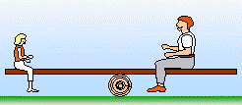
Factors that Affect Equilibrium
At equilibrium:
aA + bB cC + dD
A chemical system at equilibrium is a balance between forward and reveres reactions.
An external perturbation can change the rates of the forward and reverse reactions.
Such disturbance usually leads to a shift from the established chemical equilibrium.

Slide 54
Factors that Affect Equilibrium
At equilibrium:
aA + bB cC + dD
How we will “poke” our equilibrium:
Concentration
Pressure/volume
Temperature
Catalyst

Slide 55
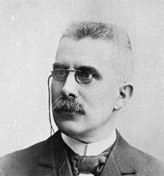
Le Châtelier’s Principle
When a chemical system at equilibrium is disturbed, it returns to equilibrium by undergoing a net reaction that reduces the effect of the disturbance.
1) The system is at equilibrium.
2) We poke/stress/disturb the system.
3) The system is no longer at equilibrium.
4) LCP says system will react and return to equilibrium.
Henry Le Châtelier
(1850-1936)

Slide 56
Change in Concentrations
aA + bB cC + dD
1) The system is at equilibrium.
2) We poke/stress/disturb the system.
double the concentration of D
3) The system is no longer at equilibrium.
4) LCP says system will react and return to equilibrium.
[C]^{c}
[D]^{d}
K =
[A]ª
[B]^{b}
[C]^{c}
[2D]^{d}
Q =
[A]ª
[B]^{b}
Q > K
The reaction will “shift left”

Slide 57
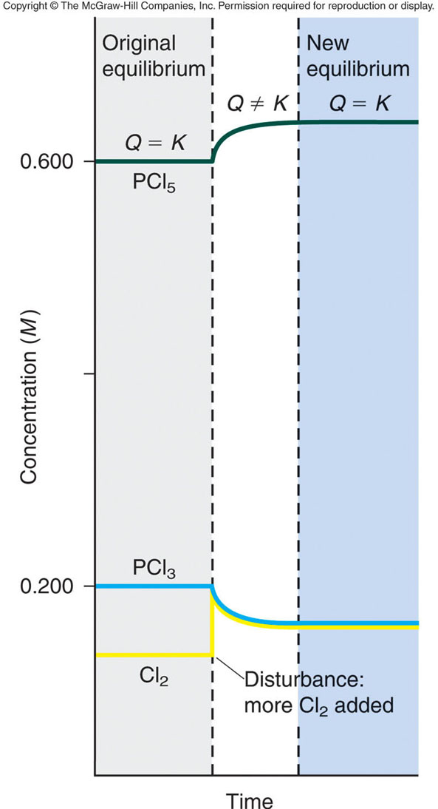
Change in Concentrations
PCl_{3(g)} + Cl_{2(g)} PCl_{5(g)}
P_{PCl5}
K =
P_{PCl3}
P_{Cl2}
The system is at equilibrium.
Q = K
2) We add Cl_{2(g)}.
3) The system is no longer at equilibrium.
Q < K
4) LCP says system will react and return to equilibrium (Q = K).
↓ PCl₃ ↓ Cl₂ ↑ PCl₅
A change in conc has no effect on the value of K!

Slide 58
Change in Concentrations
aA + bB cC + dD
[C]^{c}
[D]^{d}
K =
[A]ª
[B]^{b}
Change
Shifts the Equilibrium
Add [products]
left
Remove [products]
right
Add [reactants]
right
Remove [reactants]
left
To reach equilibrium again:
Left Shift: decrease in [products], increase in [reactants]
Right Shift: decrease in [reactants], increase in [products]

Slide 59
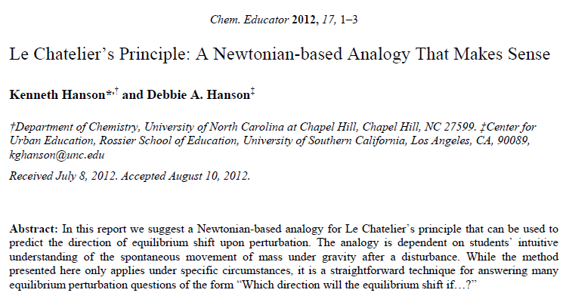
Change in Concentrations
Rather than memorize the rules or calculate Q every time, I propose an alternative strategy:
The Hanson method

Slide 60

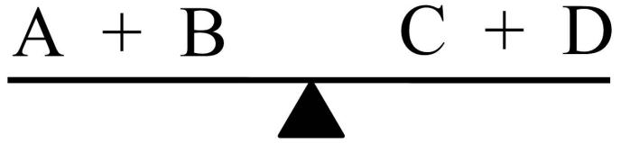
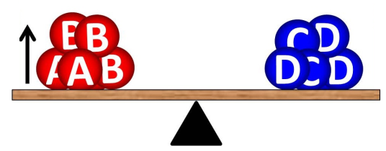
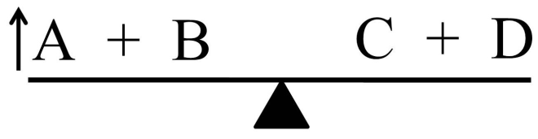
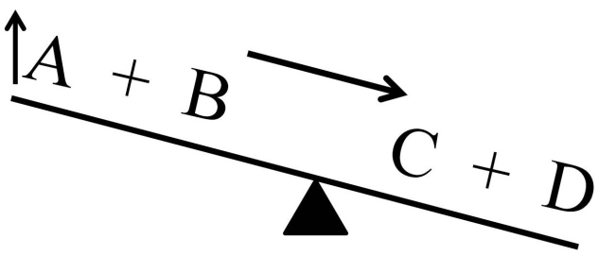
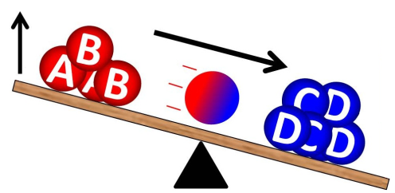
Change in Concentrations
A + B C + D
Step 1: Visualize or draw the equilibrium as a see-saw with the fulcrum under the equilibrium arrow.
Step 2: Which ever component is being added (removed), visualize an up (down) arrow attached to that side of the see-saw. For addition of A:
Step 3: Which ever component is being added (removed), visualize an up (down) arrow attached to that side of the see-saw. For addition of A:
Reaction shifts right!

Slide 61
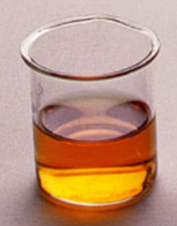
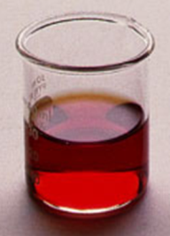
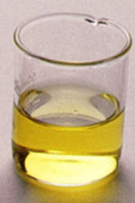
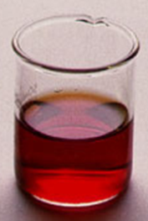
Example Problem
FeSCN²⁺_{(aq)} Fe³⁺_{(aq)} + SCN⁻_{(aq)}
red
yellow
colorless
Which way does the reaction shift if:
we add NaSCN?
FeSCN²⁺_{(aq)} Fe³⁺_{(aq)} + SCN⁻_{(aq)}
we add C₂O₄²⁻ (Fe³⁺ + C₂O₄²⁻ → Fe(C₂O₄)₃³⁻)?
FeSCN²⁺_{(aq)} Fe³⁺_{(aq)} + SCN⁻_{(aq)}
we add Fe(NO₃)₃?
FeSCN²⁺_{(aq)} Fe³⁺_{(aq)} + SCN⁻_{(aq)}

Slide 62
Chapter 14
Ch 14
Page 623

Slide 63
Reaction Quotient
aA + bB cC + dD
[C]^{c}
[D]^{d}
[C]^{c}
[D]^{d}
Q =
K =
[A]ª
[B]^{b}
[A]ª
[B]^{b}
Q = K_{c}: the system is at equilibrium
concentration of reactants and products stays the same
Q < K_{c}: the reaction proceeds to the right
generate more products, consume more reactant
Q > K_{c}: the reaction proceeds to the left
consume more products, generate more reactant
Can predict, if a reaction is not at equilibrium, which way will it shift.

Slide 64
ICE Method
cis-Stilbene trans-Stilbene
The equilibrium constant (K_{c}) for this system is 24.0 at 200°C. Suppose that initially only cis-stilbene is present at a concentration of 0.850 mol/L. How do we calculate the concentrations of cis- and trans-stilbene at equilibrium?
Step 1: Construct an ICE Table.
Step 2: Insert known information into ICE Table (in M or pressure).
Step 3: Determine the change in conc (x) that will occur as the reaction progresses.
Step 4: Complete the table.
Step 5: Set up K equation, calculate x.
Step 6: Calculate equilibrium concs.

Slide 65
Factors that Affect Equilibrium
At equilibrium:
aA + bB cC + dD
How we will “poke” our equilibrium:
Concentration
Pressure/volume
Temperature
Catalyst

Slide 66
Change in Concentrations
aA + bB cC + dD
1) The system is at equilibrium.
2) We poke/stress/disturb the system.
double the concentration of D
3) The system is no longer at equilibrium.
4) LCP says system will react and return to equilibrium.
[C]^{c}
[D]^{d}
K =
[A]ª
[B]^{b}
[C]^{c}
[2D]^{d}
Q =
[A]ª
[B]^{b}
Q > K
The reaction will “shift left”

Slide 67
Change in Concentrations
A + B C + D
Step 1: Visualize or draw the equilibrium as a see-saw with the fulcrum under the equilibrium arrow.
Step 2: Which ever component is being added (removed), visualize an up (down) arrow attached to that side of the see-saw. For addition of A:
Step 3: Which ever component is being added (removed), visualize an up (down) arrow attached to that side of the see-saw. For addition of A:
Reaction shifts right!

Slide 68
Example Problem
FeSCN²⁺_{(aq)} Fe³⁺_{(aq)} + SCN⁻_{(aq)}
red
yellow
colorless
Which way does the reaction shift if:
we add NaSCN?
FeSCN²⁺_{(aq)} Fe³⁺_{(aq)} + SCN⁻_{(aq)}
we add C₂O₄²⁻ (Fe³⁺ + C₂O₄²⁻ → Fe(C₂O₄)₃³⁻)?
FeSCN²⁺_{(aq)} Fe³⁺_{(aq)} + SCN⁻_{(aq)}
we add Fe(NO₃)₃?
FeSCN²⁺_{(aq)} Fe³⁺_{(aq)} + SCN⁻_{(aq)}

Slide 69
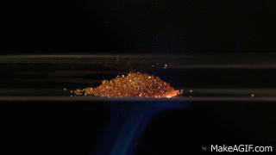
Change in Concentrations
Important Note: Only substances that appear in the expression for Q can have an effect (ignore changes in solid (s) or liquids (l)).
P
P
K_{p} =
CO₂
O₂
Double the amount of oxygen.
P
2P
Q =
CO₂
Q < K
C_{(s)} + O_{2(g)} CO_{2(g)}
O₂
LCP says system will react and return to equilibrium.
Double the amount of C_{(s)}?
Q = K
O_{2(g)} and CO_{2(g)} are unaffected
↓ O₂ ↑ CO₂

Slide 70
Example Problem
To improve air quality and obtain a useful product, chemists often remove sulfur from coal and natural gas by treating the contaminant hydrogen sulfide with O₂:
2H₂S_{(g)} + O_{2(g)} 2S_{(s)} + 2H₂O_{(g)}
What happens to:
(a) [H₂O] if O₂ is added?
(b) [H₂S] if O₂ is added?
(c) [O₂] if H₂S is removed?
(d) [H₂S] if sulfur is added?

Slide 71
14.11
At 720°C, the equilibrium constant K_{c} for the reaction
N_{2(g)} + 3H_{2(g)} 2NH_{3(g)}
is 2.37 x 10⁻³. In a certain experiment, the equilibrium concentrations are [N₂] = 0.683 M, [H₂] = 8.80 M, and [NH₃] = 1.05 M. Suppose some NH₃ is added to the mixture so that its concentration is increased to 3.65 M.
Use Le Châtelier’s principle to predict the shift in direction of the net reaction to reach a new equilibrium.
Confirm your prediction by calculating the reaction quotient Q_{c} and comparing its value with K_{c}.

Slide 72
14.11
At 720°C, the equilibrium constant K_{c} for the reaction
N_{2(g)} + 3H_{2(g)} 2NH_{3(g)}
is 2.37 x 10⁻³. In a certain experiment, the equilibrium concentrations are [N₂] = 0.683 M, [H₂] = 8.80 M, and [NH₃] = 1.05 M. Suppose some NH₃ is added to the mixture so that its concentration is increased to 3.65 M.
Use Le Châtelier’s principle to predict the shift in direction of the net reaction to reach a new equilibrium.
N_{2(g)} + 3H_{2(g)} 2NH_{3(g)}
NH₃ is added

Slide 73
14.11
At 720°C, the equilibrium constant K_{c} for the reaction
N_{2(g)} + 3H_{2(g)} 2NH_{3(g)}
is 2.37 x 10⁻³. In a certain experiment, the equilibrium concentrations are [N₂] = 0.683 M, [H₂] = 8.80 M, and [NH₃] = 1.05 M. Suppose some NH₃ is added to the mixture so that its concentration is increased to 3.65 M.
(b) Confirm your prediction by calculating the reaction quotient Q_{c} and comparing its value with K_{c}.
[NH₃]²
[1.05]²
K_{c} =
=
= 2.37 x 10⁻³
[N₂]
[H₂]³
[0.683]
[8.80]³
[NH₃]²
[3.65]²
Q_{c} =
=
= 2.86 x 10⁻²
[N₂]
[H₂]³
[0.683]
[8.80]³
Q > K

Slide 74
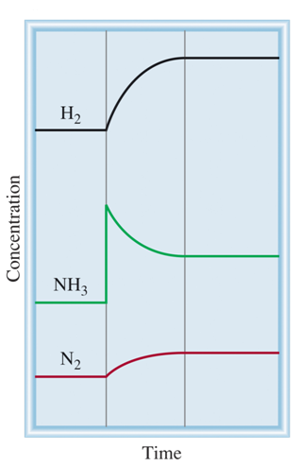
14.11
N_{2(g)} + 3H_{2(g)} 2NH_{3(g)}
Q = K
Q > K
Q = K

Slide 75

Factors that Affect Equilibrium
At equilibrium:
aA + bB cC + dD
How we will “poke” our equilibrium:
Concentration
Pressure/volume
Temperature
Catalyst

Slide 76
Change in Pressure/Volume
A_{(g)} + B_{(g)} C_{(g)}
Changing the concentration of a gaseous component causes the equilibrium to shift accordingly.
Changing the volume/pressure of a reaction will have little influence on liquid, aqueous or solid species.
Concentration of gases are greatly affected by pressure and volume changes according to the ideal gas law.
Increasing pressure (or reducing volume) effectively increase the concentration of gasses.
PV = nRT
P = (n/V)RT
P ∝ 1/V

Slide 77
Change in Pressure/Volume
A_{(g)} + B_{(g)} C_{(g)}
When the pressure is increased (or volume is decreased), the reaction proceeds to decrease the total amount of moles of gaseous substances involved in the reaction.
This effectively lowers the total pressure in the reaction vessel.
If the total number of moles of gaseous reactants equals to the total number of moles of gaseous products, the equilibrium is not affected by pressure or volume changes.
AKA- Changes in V or P will cause equilibrium to shift if Δn_{gas} ≠ 0.

Slide 78

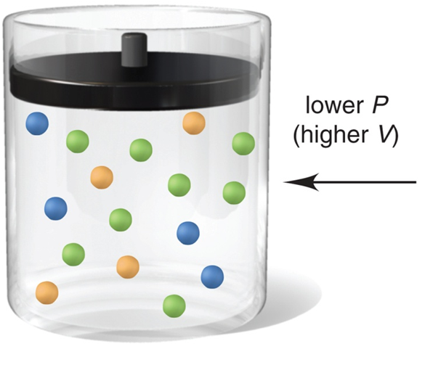
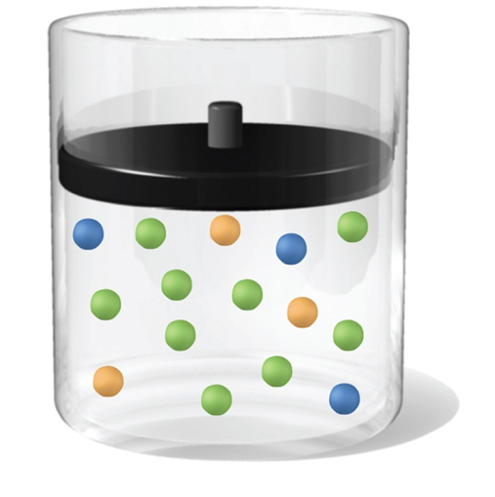
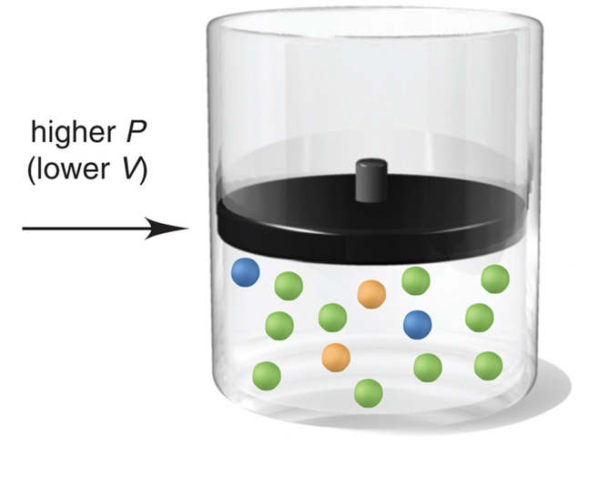

Change in Pressure/Volume
_{(g)}
_{(g)}
_{(g)}
_{(g)}
_{(g)}
_{(g)}
_{(g)}
_{(g)}
_{(g)}
Shift in the direction with more gas molecules.
Shift in the direction with less gas molecules.

Slide 79
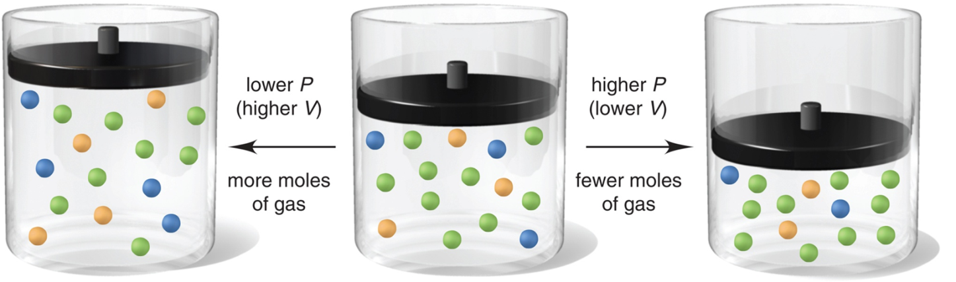
Change in Pressure/Volume Summary
A_{(g)} + B_{(g)} C_{(g)}
Change
Shifts the Equilibrium
Shift
Increase pressure
Side with fewest moles of gas
right
Decrease pressure
Side with most moles of gas
left
Increase volume
Side with most moles of gas
left
Decrease volume
Side with fewest moles of gas
right

Slide 80
Side notes: Change in Pressure/Volume
Adding an inert gas has no effect on the equilibrium position, as long as the volume does not change.
This is because all concentrations and partial pressures remain unchanged.
Changes in pressure (volume) have no effect on liquids and solids.
Changes in pressure (volume) have no effect on the value of K.
Changes in V or P will not cause the equilibrium to shift if Δn_{gas} = 0.
A_{(g)} + B_{(g)} C_{(g)} + B_{(g)}
or
A_{(g)} + B_{(g)} 2C_{(g)}

Slide 81
Example Problem
Which direction will the reaction shift if I:
a) increase pressure?
b) increase volume?
2SO₂(g) + O₂(g) ↔ 2 SO₃(g)
PCl₅(g) ↔ PCl₃(g) + Cl₂(g)
CO(g) + 2H₂(g) ↔ CH₃OH(g)
N₂O₄(g) ↔ 2 NO₂(g)
H₂(g) + F₂(g) ↔ 2 HF(g)

Slide 82
Example Problem
How would you change the volume of each of the following reactions to increase the yield of the products?
(a) CaCO₃(s) CaO(s) + CO₂(g)
(b) S(s) + 3F₂(g) SF₆(g)
(c) Cl₂(g) + I₂(g) 2ICl(g)

Slide 83
Example Problem
How will decreasing the volume affect the equilibrium in each of the following reactions?
H_{2(g)} + I_{2(g)} ↔ 2HI_{(g)}
4NH_{3(g)} + 5O_{2(g)} ↔ 4NO_{(g)} + 6H₂O_{(g)}
PCl_{5(g)} ↔ PCl_{3(g)} + Cl_{2(g)}
CaF_{2(s)} ↔ Ca²⁺_{(aq)} + 2F–_{(aq)}
SO_{2(g)} + H₂O_{(l)} ↔ H₂SO_{3(aq)}
3Fe_{(s)} + 4H₂O_{(g)} ↔ Fe₃O_{4(s)} + 4H_{2(g)}

Slide 84
Factors that Affect Equilibrium
At equilibrium:
aA + bB cC + dD
How we will “poke” our equilibrium:
Concentration
Pressure/volume
Temperature
Catalyst

Slide 85
Arrhenius Equation
Change in Temperature
Temperature changes both the equilibrium concentrations and the equilibrium constant.
A B
rate_{A→B} = k_{A} [A]
rate_{A→B} = rate_{B→A}
rate_{B→A} = k_{B} [B]
k_{A} [A] = k_{B} [B]
Rate constant A→B
k_{A}
[B]
Rate constant B→A
=
=
K
k_{B}
[A]
k_{A}, k_{B} and K are temperature dependent!

Slide 86
Change in Temperature
To determine the effect of a change in temperature on equilibrium, heat is considered a component of the system.
Heat is a product in an exothermic reaction (ΔH°_{rxn} < 0 or –ΔH).
aA + bB cC + dD + heat
Heat is a reactant in an endothermic reaction (ΔH°_{rxn} > 0 or ΔH).
heat + aA + bB cC + dD

Slide 87
Change in Temperature
Heat is a product in an exothermic reaction (ΔH°_{rxn} < 0 or –ΔH).
aA + bB cC + dD + heat
What happens if we increase the temperature?
Heat is added
aA + bB cC + dD + heat
Reaction shifts left, K decreases
What happens if we decrease the temperature?
Heat is taken away
aA + bB cC + dD + heat
Reaction shifts right, K increases

Slide 88
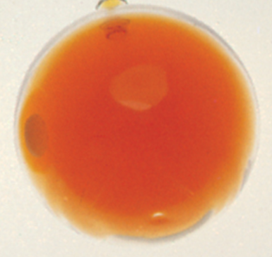

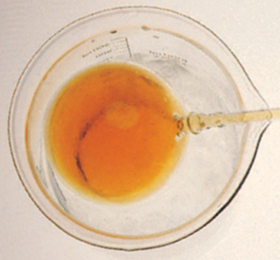
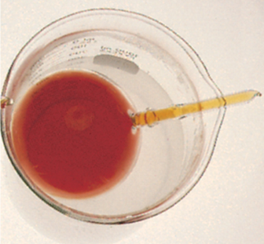
Example
N₂O_{4(g)} 2NO_{2(g)}
colorless
orange
Heat + N₂O_{4(g)} 2NO_{2(g)}
Which way does the reaction shift if:
we put it in an ice water bath?
K decreases
Heat + N₂O_{4(g)} 2NO_{2(g)}
we put it in a hot water bath?
K increases
Heat + N₂O_{4(g)} 2NO_{2(g)}

Slide 89
Example Problem
How does an increase in temperature affect the equilibrium concentration of the underlined substance and K for each of the following reactions?
(a) CaO_{(s)} + H₂O_{(g)} Ca(OH)_{2(aq)} ΔH° = -82 kJ
(b) CaCO_{3(s)} CaO_{(s)} + CO_{2(g)} ΔH° = 178 kJ
(c) SO_{2(g)} S_{(s)} + O_{2(g)} ΔH° = 297 kJ

Slide 90
Example Problems
How does an decrease in temperature affect the equilibrium concentrations and K for each of the following reactions?
2SO₂(g) + O₂(g) ↔ 2 SO₃(g) ΔHº = -180 kJ
CO(g) + H₂O(g) ↔ CO₂(g) + H₂(g) ΔHº = -46 kJ
CO(g) + Cl₂(g) ↔ COCl₂(g) ΔHº = -108 kJ
N₂O₄(g) ↔ 2 NO₂(g) ΔHº = +57 kJ
CO(g) + 2H₂(g) ↔ CH₃OH(g) ΔHº = -270 kJ

Slide 91
Factors that Affect Equilibrium
At equilibrium:
aA + bB cC + dD
How we will “poke” our equilibrium:
Concentration
Pressure/volume
Temperature
Catalyst

Slide 92
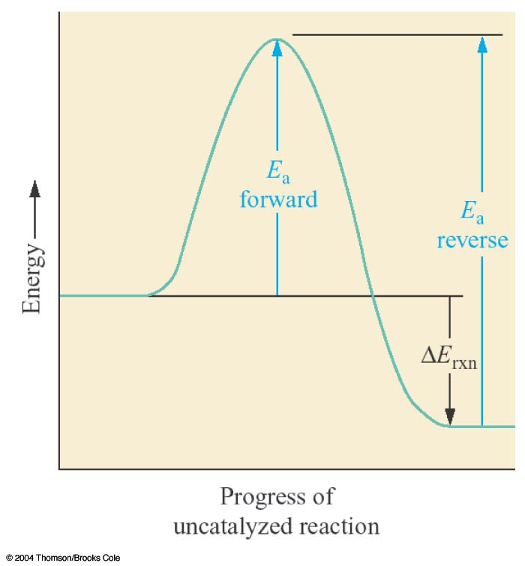
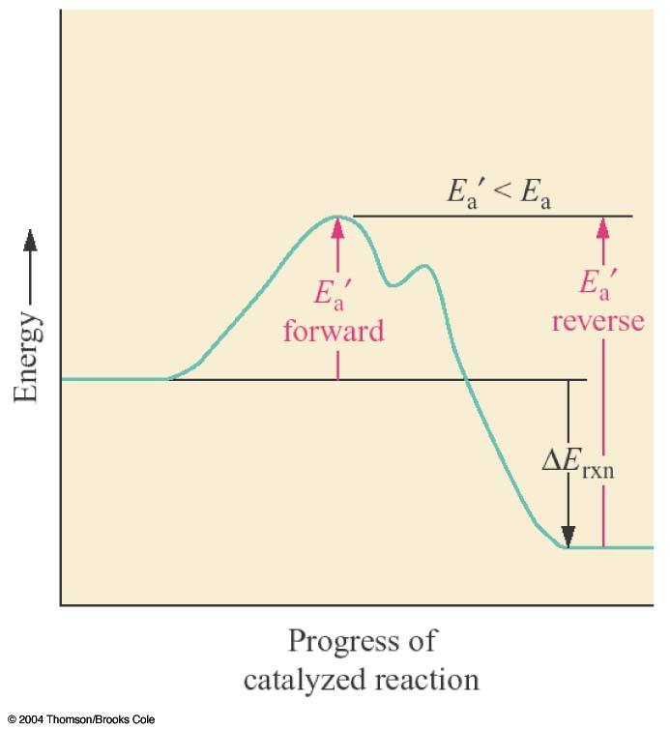
Addition of a Catalyst
A catalyst speeds up a reaction by lowering its activation energy.
It speeds up the forward and reverse reactions equally.
A catalyst causes a reaction to reach equilibrium more quickly.
It does not change the equilibrium concentration or K.

Slide 93
Example Problem
How will the addition of a catalyst affect the equilibrium concentrations and K for each of the following reactions?
2SO₂(g) + O₂(g) ↔ 2 SO₃(g)
CO(g) + H₂O(g) ↔ CO₂(g) + H₂(g)
CO(g) + Cl₂(g) ↔ COCl₂(g)
N₂O₄(g) ↔ 2 NO₂(g)
CO(g) + 2H₂(g) ↔ CH₃OH(g)

Slide 94
Chapter 14
Ch 14
Page 623

Slide 95
Factors that Affect Equilibrium
At equilibrium:
aA + bB cC + dD
How we will “poke” our equilibrium:
Concentration
Pressure/volume
Temperature
Catalyst

Slide 96
Change in Concentrations
aA + bB cC + dD
1) The system is at equilibrium.
2) We poke/stress/disturb the system.
double the concentration of D
3) The system is no longer at equilibrium.
4) LCP says system will react and return to equilibrium.
Changes in concentration will not change K.
[C]^{c}
[D]^{d}
K =
[A]ª
[B]^{b}
[C]^{c}
[2D]^{d}
Q =
[A]ª
[B]^{b}
Q > K
The reaction will “shift left”

Slide 97
Change in Concentrations
A + B C + D
Step 1: Visualize or draw the equilibrium as a see-saw with the fulcrum under the equilibrium arrow.
Step 2: Which ever component is being added (removed), visualize an up (down) arrow attached to that side of the see-saw. For addition of A:
Step 3: Which ever component is being added (removed), visualize an up (down) arrow attached to that side of the see-saw. For addition of A:
Reaction shifts right!

Slide 98
Change in Pressure/Volume Summary
A_{(g)} + B_{(g)} C_{(g)}
Change
Shifts the Equilibrium
Shift
Increase pressure
Side with fewest moles of gas
right
Decrease pressure
Side with most moles of gas
left
Increase volume
Side with most moles of gas
left
Decrease volume
Side with fewest moles of gas
right
Adding an inert gas has no effect on the equilibrium position.
Changes in pressure (volume) have no effect on the value of K.
Changes in V or P will not cause the equilibrium to shift if Δn_{gas} = 0.

Slide 99
Change in Temperature
Heat is a product in an exothermic reaction (ΔH°_{rxn} < 0 or –ΔH).
aA + bB cC + dD + heat
What happens if we increase the temperature?
Heat is added
aA + bB cC + dD + heat
Reaction shifts left, K decreases
What happens if we decrease the temperature?
Heat is taken away
aA + bB cC + dD + heat
Reaction shifts right, K increases

Slide 100
Addition of a Catalyst
A catalyst speeds up a reaction by lowering its activation energy.
It speeds up the forward and reverse reactions equally.
A catalyst causes a reaction to reach equilibrium more quickly.
It does not change the equilibrium concentration or K.

Slide 101
LCP Summary
Change Equilibrium
Constant
Change
Shift Equilibrium
Concentration
yes
no
Pressure
yes*
no
Volume
yes*
no
Temperature
yes
yes
Catalyst
no
no
*Dependent on relative moles of gaseous reactants and products

Slide 102
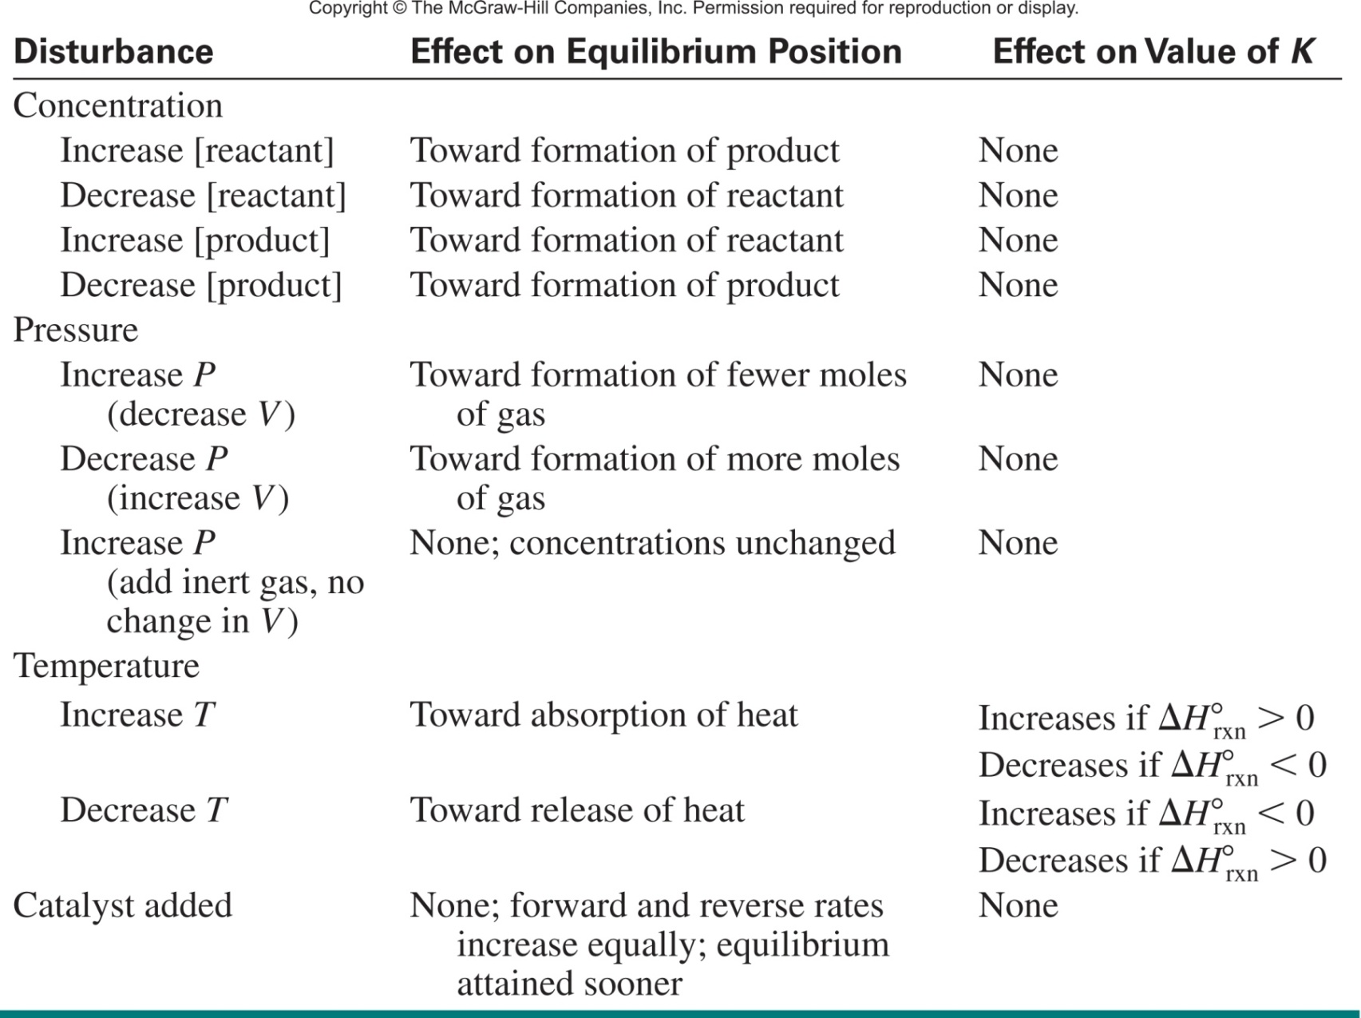
Table 17.4 Effects of Various Disturbances on a System at Equilibrium

Slide 103
14.13
Consider the following equilibrium process between dinitrogen tetrafluoride (N₂F₄) and nitrogen difluoride (NF₂):
N₂F₄(g) 2NF₂(g) ΔH° = 38.5 kJ/mol
Predict the changes in the equilibrium and K if:
the reacting mixture is heated at constant volume.
(b) some N₂F₄ gas is removed from the reacting mixture at constant temperature and volume.
(c) the pressure on the reacting mixture is decreased at constant temperature.
(d) a catalyst is added to the reacting mixture.

Slide 104
14.13
Consider the following equilibrium process between dinitrogen tetrafluoride (N₂F₄) and nitrogen difluoride (NF₂):
N₂F₄(g) 2NF₂(g) ΔH° = 38.5 kJ/mol
Predict the changes in the equilibrium and K if:
the reacting mixture is heated at constant volume.
Heat + N₂F_{4(g)} 2NF_{2(g)}
Reaction shifts right, generates more product and increase K.

Slide 105
14.13
Consider the following equilibrium process between dinitrogen tetrafluoride (N₂F₄) and nitrogen difluoride (NF₂):
N₂F₄(g) 2NF₂(g) ΔH° = 38.5 kJ/mol
Predict the changes in the equilibrium and K if:
(b) some N₂F₄ gas is removed from the reacting mixture at constant temperature and volume.
Heat + N₂F_{4(g)} 2NF_{2(g)}
Reaction shifts left, generates more reactants and K stays the same.

Slide 106
14.13
Consider the following equilibrium process between dinitrogen tetrafluoride (N₂F₄) and nitrogen difluoride (NF₂):
N₂F₄(g) 2NF₂(g) ΔH° = 38.5 kJ/mol
Predict the changes in the equilibrium and K if:
(c) the pressure on the reacting mixture is decreased at constant temperature.
pressure
decrease
volume increase
=
Heat + N₂F_{4(g)} 2NF_{2(g)}
1 gas molecule
2 gas molecules
Reaction shifts right, generates more products and K stays the same.

Slide 107
14.13
Consider the following equilibrium process between dinitrogen tetrafluoride (N₂F₄) and nitrogen difluoride (NF₂):
N₂F₄(g) 2NF₂(g) ΔH° = 38.5 kJ/mol
Predict the changes in the equilibrium and K if:
(d) a catalyst is added to the reacting mixture.
Heat + N₂F_{4(g)} 2NF_{2(g)}
A catalyst causes a reaction to reach equilibrium more quickly.
It does not change the equilibrium concentration or K.

Slide 108
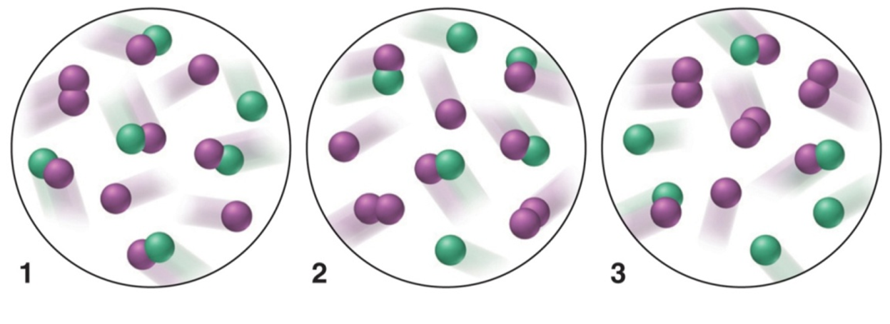
Example Problem
X_{(g)} + Y_{2(g)} XY_{(g)} + Y_{(g)}
ΔH > 0
(a) If K = 2 at the temperature of the reaction, which scene represents the mixture at equilibrium?
(b) Will the reaction mixtures in the other two scenes proceed toward reactant or toward products to reach equilibrium?
For the mixture at equilibrium, how will a rise in temperature affect [Y₂] and K?
How will a decrease in pressure influence the mixture at equilibrium?

Slide 109
Example Problem
X_{(g)} + Y_{2(g)} XY_{(g)} + Y_{(g)}
ΔH > 0
[XY][Y]
K =
= 2
[X][Y₂]
(a) If K = 2 at the temperature of the reaction, which scene represents the mixture at equilibrium?
[5][3]
[4][2]
[3][1]
Q₁ =
= 15
Q₂ =
= 2
Q₃ =
= 0.33
[1][1]
[2][2]
[3][3]
At equilibrium.

Slide 110
Example Problem
X_{(g)} + Y_{2(g)} XY_{(g)} + Y_{(g)}
ΔH > 0
(b) Will the reaction mixtures in the other two scenes proceed toward reactant or toward products to reach equilibrium?
[5][3]
[4][2]
[3][1]
Q₁ =
= 15
Q₂ =
= 2
Q₃ =
= 0.33
[1][1]
[2][2]
[3][3]
Shift left.
Towards reactants.
At equilibrium.
Shift right.
Towards products.

Slide 111
Example Problem
X_{(g)} + Y_{2(g)} XY_{(g)} + Y_{(g)}
ΔH > 0
For the mixture at equilibrium, how will a rise in temperature affect [Y₂] and K?
heat + X_{(g)} + Y_{2(g)} XY_{(g)} + Y_{(g)}
Reaction shifts right, generates more product and K increases.

Slide 112
Example Problem
X_{(g)} + Y_{2(g)} XY_{(g)} + Y_{(g)}
ΔH > 0
How will a decrease in pressure influence the mixture at equilibrium?
X_{(g)} + Y_{2(g)} XY_{(g)} + Y_{(g)}
2 gas molecules
2 gas molecules
Changes in P will not cause the equilibrium to shift if Δn_{gas} = 0.

Slide 113
Real World Application
Haber-Bosch process:
N_{2(g)} + 3H_{2(g)} 2NH_{3(g)}
ΔH°_{rxn} = -91.8 kJ
You are tasked with feeding 7.3 billion people. NH₃ is crucial to increasing food production by maximizing crop yield.
How do you increase the rate of production of NH₃?
Increase the product formation rate:
Build more reactors.
Add a catalyst.
Increase the temperature.
Shift the equilibrium:
Decrease the temperature.
Increase the pressure.
Decrease [NH₃] by removing NH₃ as it forms.
Add more H₂ and N₂ as its consumed.

Slide 114
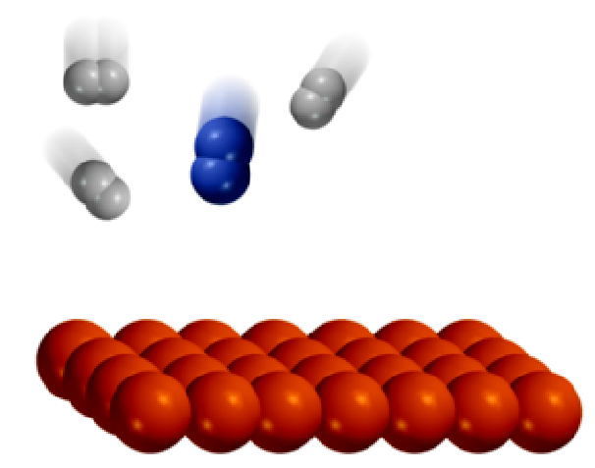
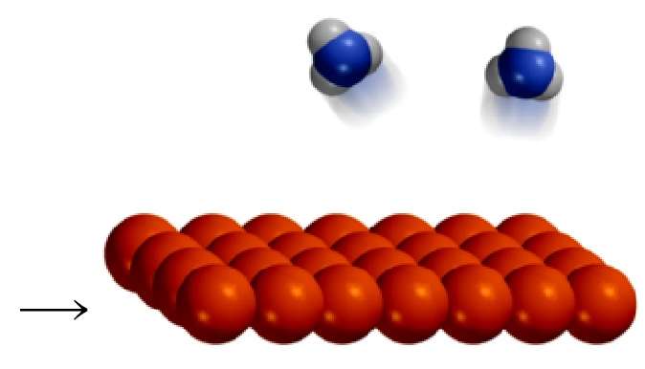
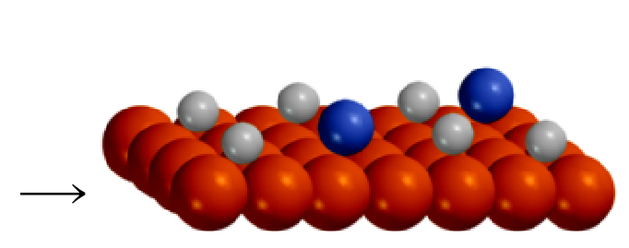
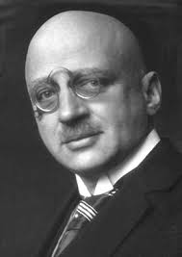
Important Heterogeneous Reactions
Haber-Bosch Reaction
150 atm
400-600 °C
Fe/Al₂O₃
N₂ (g) + 3H₂ (g) 2NH₃ (g)
catalyst
Fritz Haber
1918 Nobel Prize in Chemistry

Slide 115
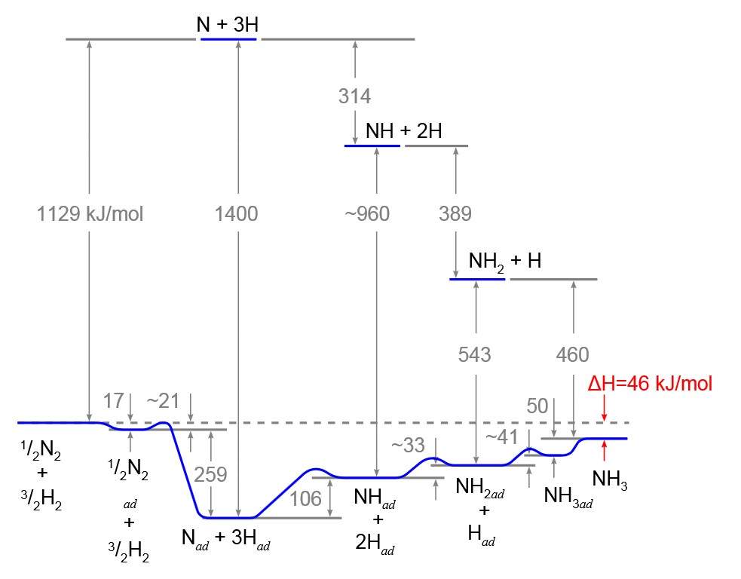
Haber-Bosch Process
Uncatalyzed
N₂ + 3H₂ 2NH₃
Catalyst gets you to NH₃ quicker but the [NH₃] is dictated by K.
Catalyzed

Slide 116
Real World Application
Haber-Bosch process:
N_{2(g)} + 3H_{2(g)} 2NH_{3(g)}
ΔH°_{rxn} = -91.8 kJ
You are tasked with feeding 7.3 billion people. NH₃ is crucial to increasing food production by maximizing crop yield.
How do you increase the rate of production of NH₃?
Increase the product formation rate:
Build more reactors.
Add a catalyst.
Increase the temperature.
Shift the equilibrium:
Decrease the temperature.
Increase the pressure.
Decrease [NH₃] by removing NH₃ as it forms.
Add more H₂ and N₂ as its consumed.

Slide 117
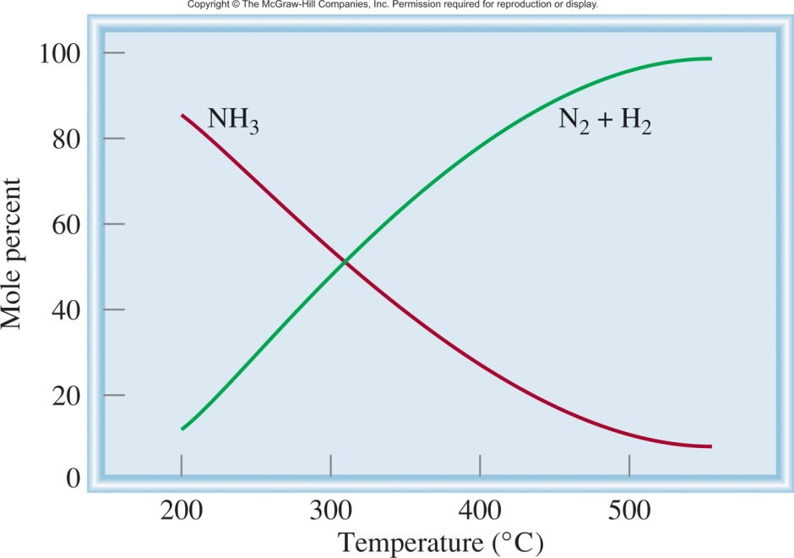
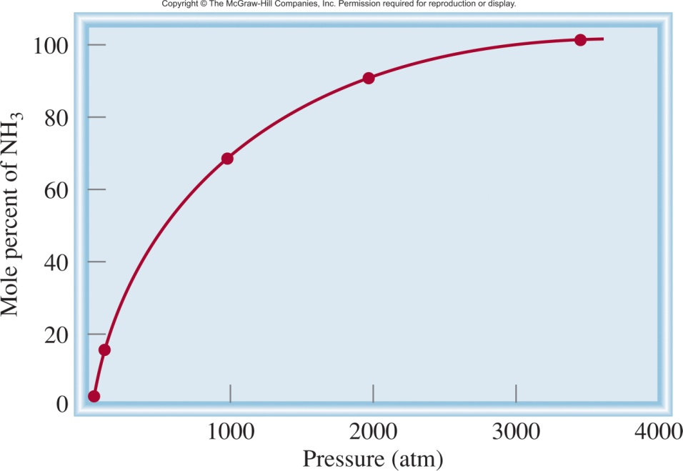
Haber-Bosch Process
N_{2(g)} + 3H_{2(g)} 2NH_{3(g)}
ΔH°_{rxn} = -91.8 kJ
Which way does the reaction shift if:
slow
fast
we increase the temperature?
Reaction shifts left, less NH₃.
But…it gets there faster!
we decrease the temperature?
Reaction shifts right, more NH₃.
But…it gets there slower!
we increase the pressure?
Reaction shifts right, more NH₃.

Slide 118
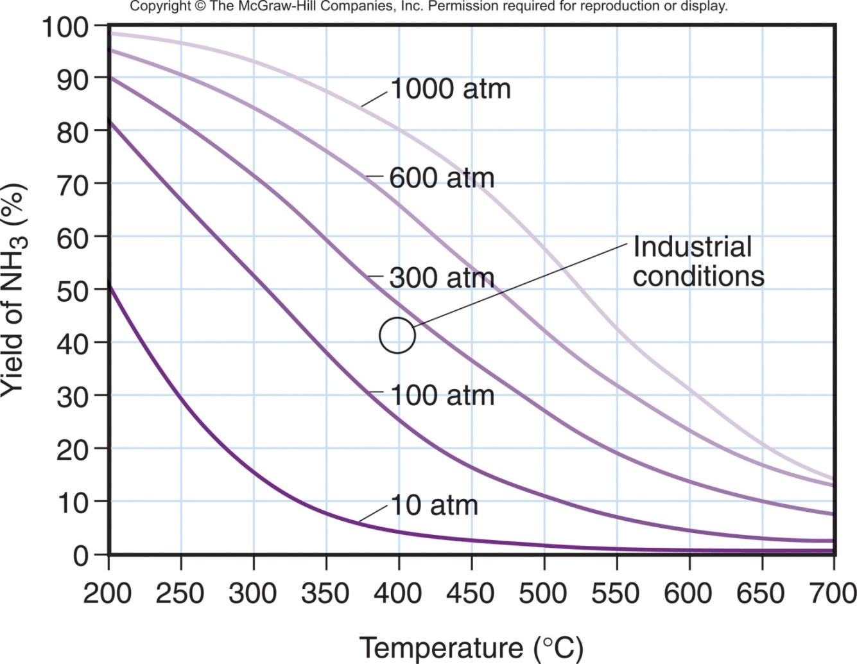
Haber-Bosch Process
N_{2(g)} + 3H_{2(g)} 2NH_{3(g)}
slow
ΔH°_{rxn} = -91.8 kJ
Which way does the reaction shift if:
we increase the temperature?
Reaction shifts left, less NH₃.
But…it gets there faster!
fast
we decrease the temperature?
Reaction shifts right, more NH₃.
But…it gets there slower!
At very high P and low T (top left), the yield is high, but the rate is low. Industrial conditions (circle) are between 200 and 300 atm at about 400°C.
we increase the pressure?
Reaction shifts right, more NH₃.

Slide 119
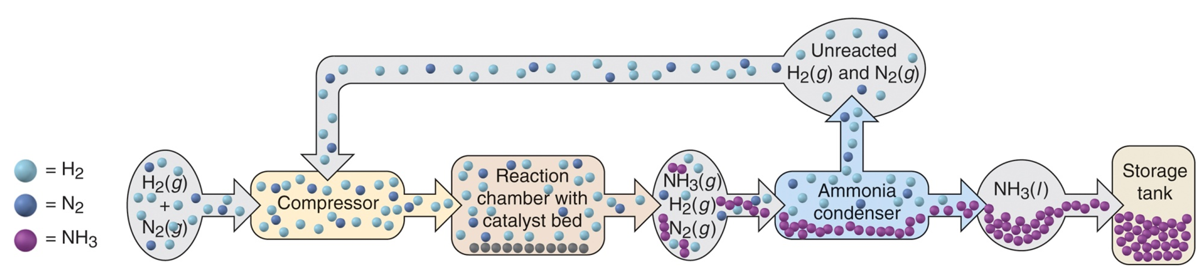
Haber-Bosch Process
N_{2(g)} + 3H_{2(g)} 2NH_{3(g)}
ΔH°_{rxn} = -91.8 kJ
300 atm at 400°C
Increase the product formation rate:
Add a catalyst.
Increase the temperature.
Shift the equilibrium:
Decrease the temperature.
Increase the pressure.
Decrease [NH₃] by removing NH₃ as it forms.
Add more H₂ and N₂ as its consumed.

Slide 120
Chapter 14
Ch 14
Page 623

